Slide 1
SHOCK
www.tatvakrishna.com

Slide 2
OUTLINE
DEFINITION
TYPES OF SHOCK
PATHOPHYSIOLOGY OF SHOCK
CLINICAL MENIFESTATION OF SHOCK
DIAGNOSIS OF SHOCK
MONITORING OF SHOCK
SEVERITY OF SHOCK
COMPLICATIONS OF SHOCK
MANAGEMENT OF SHOCK
HOW TO EXAAMINE A PT OF SHOCK IN EMERGENCY WARD

Slide 3
DEFINITION
A CONDITION IN WHICH CIRCULATION FAILS TO MEET THE NUTRITIONAL NEEDS OF CELLS
&
AT THE SAME TIME FAILS TO REMOVE THE METABOLIC WASTE PRODUCTES.
CHARACTERSIED BY : HYPOPERFUSION AND SEVERE DYSFUNCTION OF VITAL ORGANS.

Slide 4
TYPES OF SHOCK
HYPOVOLAEMIC SHOCK
CARDIOGENIC SHOCK
OBSTRUCTIVE SHOCK
DISTRIBUTIVE SHOCK

Slide 5
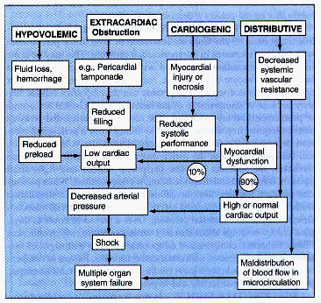
PATHOPYSIOLOGY OF SHOCK

Slide 6
HYPOVOLAEMIC SHOCK
D/T LOSS OF INTRAVASCULAR VOLUME e.g.
Haemorrhage (trauma-ext. or int. bleeding)
Fluid loss (vomiting, diarrheoa,burn,DM/DI)
Internal sequestration(intestinal obstruction,pancreatitis,ascites,haemoperitoneum)

Slide 7
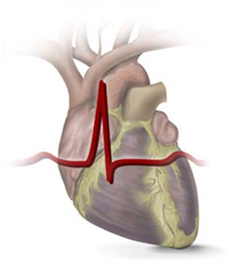
CARDIOGENIC SHOCK
USUALLY D/T PRIMARY DYSFUNCTION OF ONE VENTRICLE e.g.
Myocardial infarction
Cardiac arrythmias
Valvular heart disease
Severe CHF
Myocarditis

Slide 8
OBSTRUCTIVE SHOCK
CARDIAC COMPRESSIVE SHOCK
WHEN HEART IS COMPRESSED ENOUGH FROM OUTSIDE TO dec. C.O. e.g.
Pulmonary embolism.
Cardiac temponade.
Tension pneumothorax.
Diaphragmatic rupture with herniation of bowel into chest.

Slide 9
DISTRIBUTIVE SHOCK
NEUROGENIC SHOCK
SEPTIC SHOCK
ANAPHYLACTIC SHOCK
ENDOCRINAL SHOCK eg.acute adrenal insufficiency

Slide 10
NEUROGENIC SHOCK
1. D/T TRAUMATIC OR PHARMACOLOGICAL BLOCADE OF SYMP. N.S. eg.
Trauma to spinal cord
Spinal anaesthesia
2. VASOVAGAL SHOCK
3. PSYCOGENIC SHOCK eg. Immeditely follows a sudden fright(bad news,accidents, severe pain d/t blow to testes)

Slide 11
SEPTIC SHOCK
DEFINE AS SEPSIS WITH HYPOTENSION(SBP<90 mmHg)eg.severe septicemia,peritonitis,meningitis
most often d/t gram –ve septicaemia, having three stage
Warm shock(d/t vasodilatation & inc. C.O.)
Cold shock(d/t vasoconstriction & dec. C.O.)
Multiorgan failure k/a sepsis syndrome(d/t poor tissue perfusion & microthrombi formation)

Slide 12
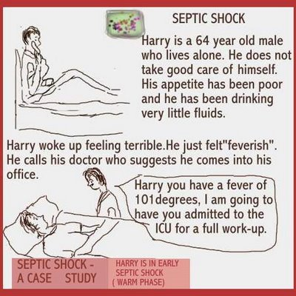

Slide 13
ANAPHYLACTIC SHOCK
VARIOUS ALLERGENS (eg. pollens,foodstuffs,penicillin,stings) ANTIGENS COMBINE WITH IgE ON MAST CELLS & BASOPHILLS REALISING LARGE AMOUNT OF 1.HISTAMINE & 2.SRS-A WHICH CAUSES :
Bronchospasm & Laryngeal oedema
Resp. distress with hypoxia
Massive vasodilatation,hypotension
Cardiac arrest

Slide 14
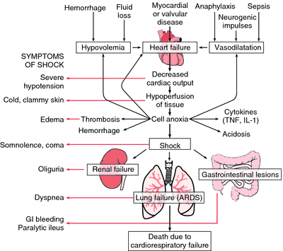
PATHOPHYSIOLOGY OF SHOCK

Slide 15
CLINICAL MENIFESTATION OF SHOCK
1.Cardiovascular -fast and feeble pulse
-SBP <80mmHg
-feeble heart sound, Tachycardia
2.Respiratory -Tachypnoea, Cyanosis
-Cheyne stroke breathing
3.CNS -Restlessness, confusion
-disorientation, stupor, coma
4.Renal -oliguria (u.o. <20 ml/hr )
5.Skin -cold, pale extremities
-perespiration

Slide 16
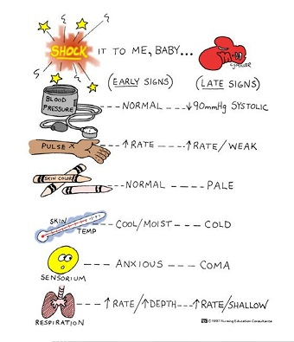

Slide 17
DIAGNOSIS
SHOCK SHOULD BE ANTICIPATED.
SIGNS OF SHOCK ARE GENRALLY……
Fall in BP, Fast- feeble pulse,palpitation
Sweating, Pallor, Coldness of skin
Fainting/giddiness on standing
If shock continues,by the next day…
Oliguria/Anuria(if shock >90 min)
Breathlessness & cerebral symptoms

Slide 18
Conti…
1.HYPOVOLEMIC SHOCK :
[clue in h/o- fluid loss? dec. intake? eg. In vomiting,poor appetite]
[clue in physical exam- Dry MM,dec. U.O.,diminished peripheral pulses & poor color]
[other-low CVP, low C.O., may be elevated B.U.& creatinine]

Slide 19
Cont…
2. CARDIOGENIC SHOCK
[clue in h/o- CHD?,Rescent cardiac surgery?,other cardiac disease]
[clue in exam- murmur?,S3 gallop?,elevated JVP?,hepatomegaly?]
[other- CVP raised,low C.O.,chest X-ray may show pulmonary oedema]

Slide 20
Cont…
3.DISTRIBUTIVE SHOCK
[clue in h/o- Trauma of spinal cord?,post operative sepsis?,psycogenic history?,multiple bee stings?,drug allergy eg.penicillin?,poisoning?]
[In septic shock- fever?,source of infection?,Ix- may show WBC high/low, cogulopathy presence]
[other- low CVP, High C.O.]

Slide 21
MONITORING
TO DETECT PHYSIOLOGICAL STATUS & EFFECTIVENESS OF INTERVENTION DONE.
CLINICAL PARAMETERS ARE :
P/R, BP, Urine output
Skin color, ECG
Blood gases, glucose, electrolytes
CVP & pulmonary A. catheterization by SWAN-GANZ Catheter

Slide 22
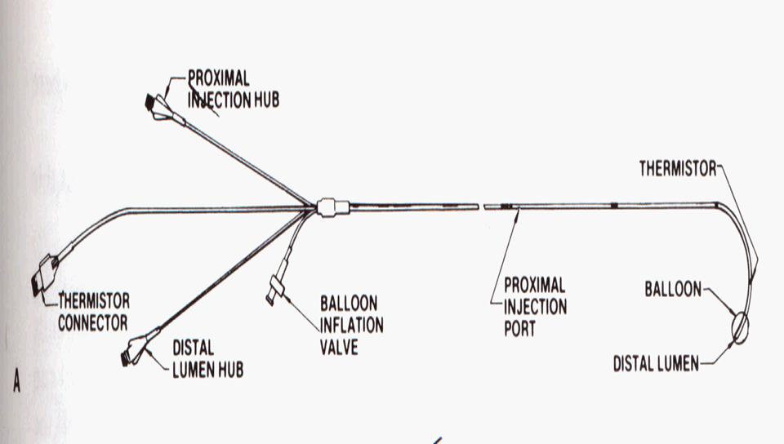
SWAN-GANG CATHETER

Slide 23
SEVERITY OF SHOCK
MILD
blood loss<20%
BP,
P/R -normal
U.O. – normal
thirsty & cold
MODERATE
20-40%
P/R inc but < 100/min
oliguria
SEVERE
> 40 %
Rapid pulse
Low BP
Oliguria/anuria
pallor

Slide 24
COMPLICATIONS OF SHOCK
ACUTE RENAL FAILURE
ACUTE RESPIRATORY DISTRESS SYNDROME
HAEMATOGENIC FAILURE
HEPATIC FAILURE
MULTIPLE ORGAN FAILURE

Slide 25
MANAGEMENT
RESUSCITATION (clear airway maintaining adequate ventilation & oxygenation.
ELEVATION OF FOOT END OF BED
IMMEDIATE CONTROL OF BLEEDING
EXTRACELLULAR FLUID REPLACEMENT
DRUGS :
CHRONOTROPIC AGENTS : inc. coronary flow & HR eg. Atropine
INOTROPIC AGENTS : improve cardiac muscle contraction eg. Dopamine
VASOCONSTRICTORS : specialy in neurogenic eg. Phenylephrine
BETA BLOCKER : spcialy in cardiogenic eg. propranolol

Slide 26
Cont…
TREATMENT OF ACIDOSIS : By soda bi carb 7.5 %.
STEROIDES : To reducing inflammatory chemicals.
ADRENALINE : Best remedy for anaphylactic shock.
ANTIBIOTICS : particularly in septic shock.
HEPARIN : Prevent intravascular clotting in septic & traumatic shock.
SURGICAL M/T : as in trauma, intestinal obst.

Slide 27
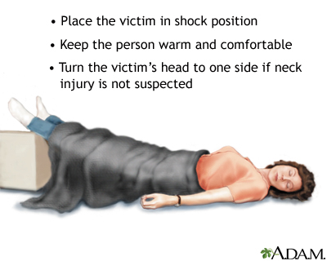

Slide 28

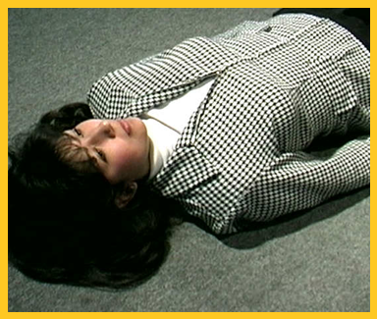

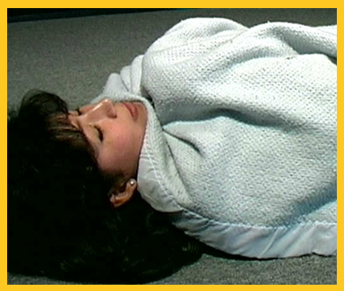

Shock
  Lay the victim down
  Cover
  Raise feet
© Business & Legal Reports, Inc. 1110

Slide 29
HOW TO EXAMINE A PT OF SHOCK IN EMERGENCY WARD?
EXAMINATION HEAD TO TOE
GEN. EXAMINATION
Palpate skull for fracture
Examine ear for discharge
Eye – pupil reaction
Tongue – dry? Bite mark?
Neck rigidity
Chest & abdomen
Give painful stimulus- note weakness of limbs,facial nerve.
ASK H/O ONSET, DM, HIGH FEVER,POISON,DRUG etc.
Temprature
Pulse – fast/slow/irregular
Check BP
Respiration: slow/rapid/cheyne stroke/irregular
Breath smell: poison/alcohol
Note the posture
Severe sweating:hypoglycemia?
M/T- acc. To cause with immediate RESUSCITATION.

Slide 30
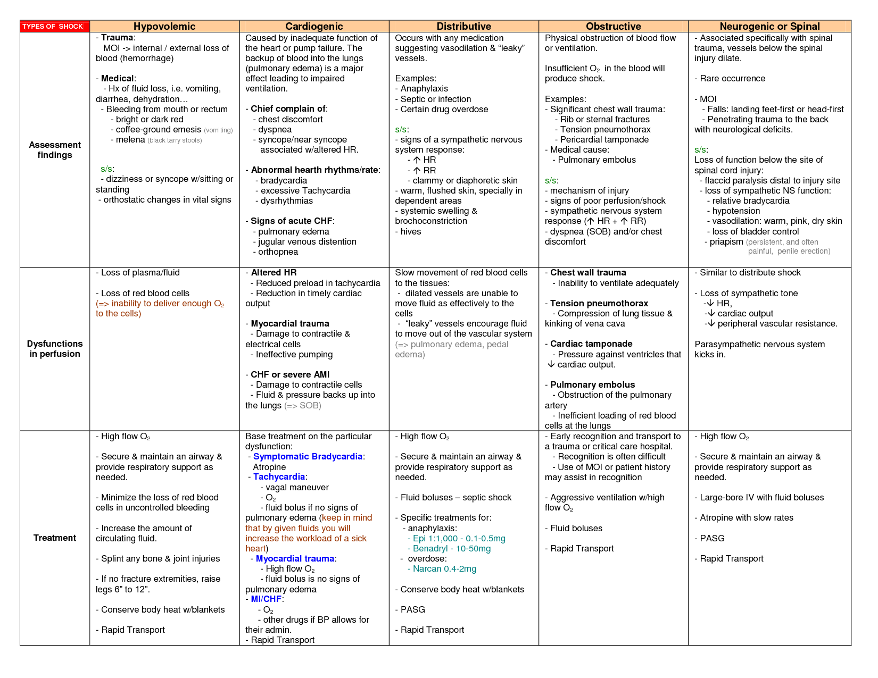
SUMMARY

Slide 31

THANK YOU

