Slide 1
APPENDICITIS
www.tatvakrishna.com

Slide 2
Appendicitis
Most common general surgical emergency
Approx. 8% of western population have appendicitis during their life
Peak incidence between 10-30 years of age
Worldwide perforated appendicitis is the leading general surgical cause of death

Slide 3
Embryology and anatomy
Derivative of midgut (8th week of gestation)
Length of varies from 2-20 cm (avg.9 cm in adult)
Appendiceal artery branch of ileocolic artery
Base is located at inferior aspect of the cecum where the taenia coli converges

Slide 4
Embyology and anatomy cont.
Tip of the appendix is variable
Different locations are:-
preilieal
postilieal
promontoric
pelvic
sub-cecal
paracolic
retroperitoneal in 7% of population

Slide 5
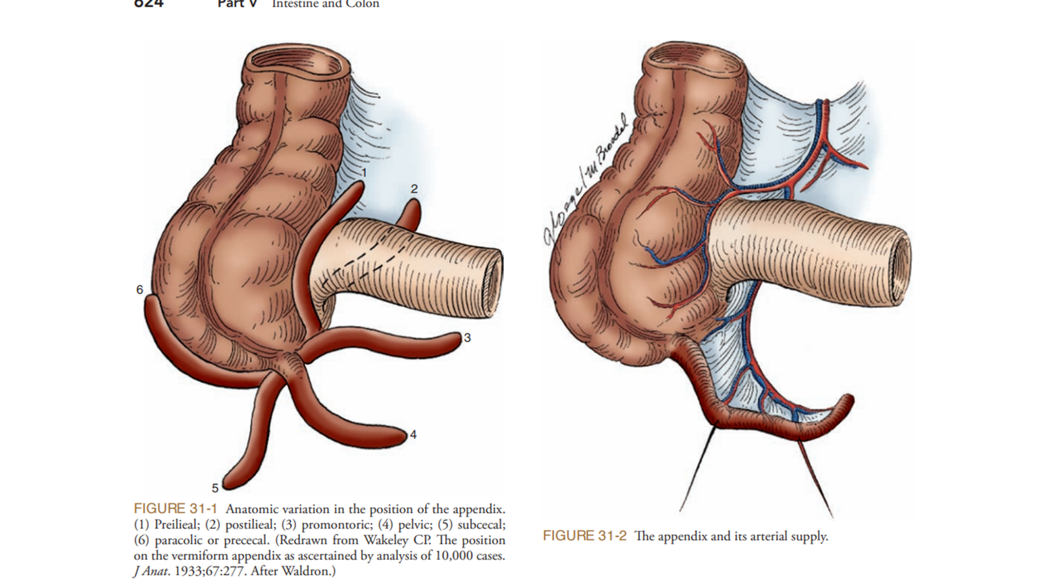

Slide 6
Acute appendicitis
Inflammation of appendix
Significant public health problem
lifetime incidence of 8.6% in men and 6.7% in women
Highest incidence occurring in the second and third decade of life

Slide 7
Aetiology and Pathogenesis
Luminal obstruction:-
Lymphoid hyperplasia in paediatric population
Fecaliths
Fibrosis
Foreign bodies (food, parasites and calculi)
Neoplasia in adult

Slide 8
Aetiology and Pathogenesis contd.
Obstruction leads to bacterial overgrowth and increased intraluminal pressure
Which leads to referred visceral pain to the periumbilical region
Impaired venous drainage, mucosal ischemia leading to bacterial translocation
Subsequently gangrene and intraperitoneal infection and perforation
Most common aerobic and anaerobic bacteria isolated
(Escherichia coli and Bacteroides fragilis)

Slide 9
Clinical Presentation
History
Elicit an accurate history from the patient or family member(in the case of pediatric patients)
Inflammation progress from visceral peritoneum to parietal peritoneum
Patient presenting with migratory pain(from periumbilical to RIF)
Classic sign of appendicitis

Slide 10
Clinical Presentation contd.
Inflammation result in anorexia, nausea, vomiting, and fever
Regional inflammation:- can also present with
An ileus,
Diarrhoea,
Small bowel obstruction, and
Haematuria

Slide 11
Physical Examination
Lay quite still due to parietal peritonitis
Warm to the touch (low-grade fever)
Raised pulse rate(tachycardia)
Demonstrate focal tenderness with guarding/Rebound tenderness (McBurney’s point)
Certain physical signs helpful in discerning the location of the appendix

Slide 12
Physical Examination contd.
Rovsing’s sign:-
Pain in the RLQ after release of gentle pressure from LLQ(normal position)
Dunphy’s sign:-
Pain with coughing (retrocecal appendix)
Obturator sign:-
Pain with internal rotation of the hip (pelvic appendix);
Iliopsoas sign:-
Pain with flexion of the hip (retrocecal appendix)
Pain with rectal or cervical examinations is also suggestive of pelvic appendicitis

Slide 13
Laboratory Findings
Leukocytosis of 10,000 cells/mm3
Lab.Values Predicting perforated appendicitis:-
Higher leukocytosis(∼17,000 cells/mm3)
Increased C-reactive protein
Bilirubin
Il-6, and procalcitonin
Pregnancy test is also essential in women of childbearing age
Urinalysis valuable to rule out nephrolithiasis or pyelonephritis

Slide 14
Imaging
Appropriate for patients in whom a diagnosis is unclear
Who are at high risk from:-
Operative intervention &
General anesthesia
(pregnant patients or patients with multiple comorbidities)
Routine use of cross sectional imaging reduces the rate of negative laparotomies(<10 % in Male patients & <20 % in female patients)
Commonly utilized imaging modalities include computerized tomography (CT), ultrasound (US), and magnetic resonance imaging (MRI)

Slide 15
C.T.Scan
A contrast-enhanced CT scan has a sensitivity and specificity of 95%(approx.) in diagnosing acute appendicitis
Avoided in patients with allergies to contrast or low estimated glomerular filtration rate
More sensitive and specific than ultrasound in diagnosing appendicitis

Slide 16
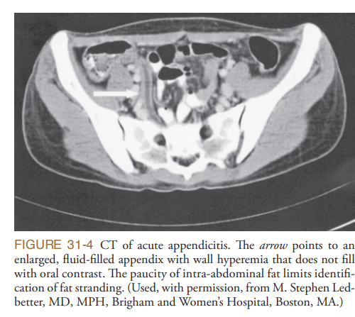

Slide 17
Features on a CT scan that suggest appendicitis
Enlarged lumen
Double wall thickness (greater than 6 mm)
Peri appendiceal fat stranding
Appendicolith

Slide 18
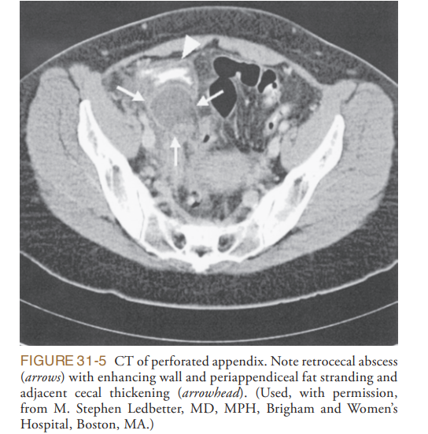

Slide 19
Ultrasonography of Abdomen
Sensitivity 85% and specificity of more than 90% (Approx.)
Advantages:-
Non invasive
Cheaper
More readily available than CT scan
Does not expose patients to ionizing radiation,
Disadvantages:-
User-dependent
limited utility in obese patients
Graded compressions are painful in patients with peritonitis

Slide 20
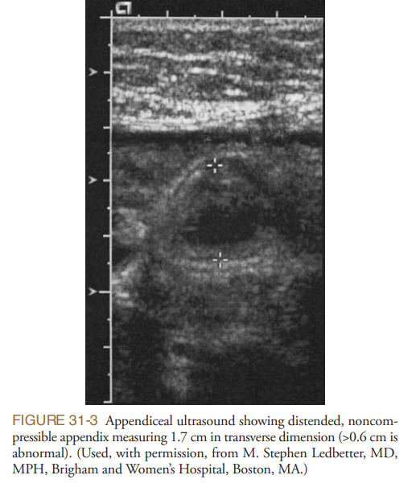

Slide 21
USG contd.
An easily compressible appendix with <5 mm in diameter generally rules out appendicitis
Ultrasound finding that suggest appendicitis:-
Diameter of greater than 6 mm
Pain on compression with US prob(prob tenderness present)
Presence of an appendicolith
Increased echogenicity of the fat
Peri-appendiceal fluid

Slide 22
MRI
Not available easily
MRI is an expensive test
Requires significant expertise to perform and interpret
Recommended in patients where risk of ionizing radiation outweighs the relative risk contrast CT scan(Pregnant or pediatric patients)

Slide 23
Differential Diagnosis
Acute mesenteric adenitis
Caecal diverticulitis
Meckel’s diverticulitis
Acute ileitis
Crohn’s disease
Ureteric colic
Acute pelvic inflammatory disease
Torsion of ovarian cyst or graafian follicle, and
Acute gastroenteritis

Slide 24
Conservative Treatment of Appendicitis
Offered to informed patients and with significant phobia of surgery
Not the standard modality of treatment of appendicitis
Nonoperative group required an appendectomy within 1 year
Rate of adverse events following antibiotics therapy is higher
Patients who recurred presented more frequently with complicated appendicitis

Slide 25
Operative Treatment of Appendicitis
Appropriate treatment of acute appendicitis is emergency appendectomy
Fluid resuscitation as indicated
Intravenous administration of broad-spectrum antibiotics should be started immediately
Operation should proceed without undue delay

Slide 26
Open Appendectomy
Under GA or regional anesthesia(SAB)
Patient is placed in the supine position
Choice of incision is surgeon’s preference:-
1.McBurney:-oblique muscle-splitting incision
2.RockeyDavis:-a transverse incision
3.Conservative midline incision
Peritoneal cavity is opened

Slide 27
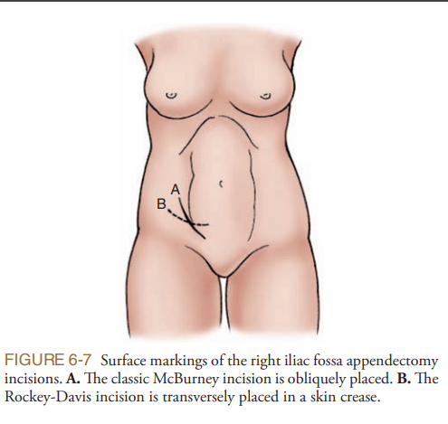

Slide 28
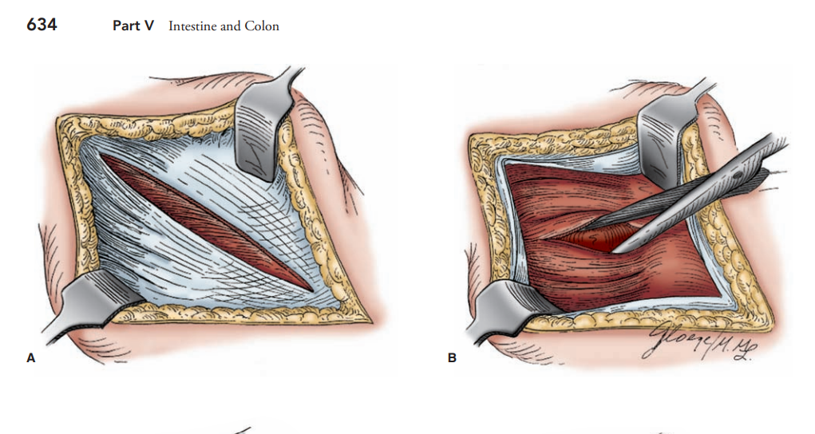

Slide 29
Open appendicectomy contd.
Cecum is grasped by the taeniae and delivered into the wound
Base of the appendix and appendiceal tip identified
Mesoappendix along with appendicular artery ligated and divided
Appendix is crushed just above the base, ligated with and divided
Stump is either cauterized or inverted by a purse-string or Z suture technique
Abdomen is thoroughly irrigated and the wound closed in layers
Skin is sutured or clipped

Slide 30
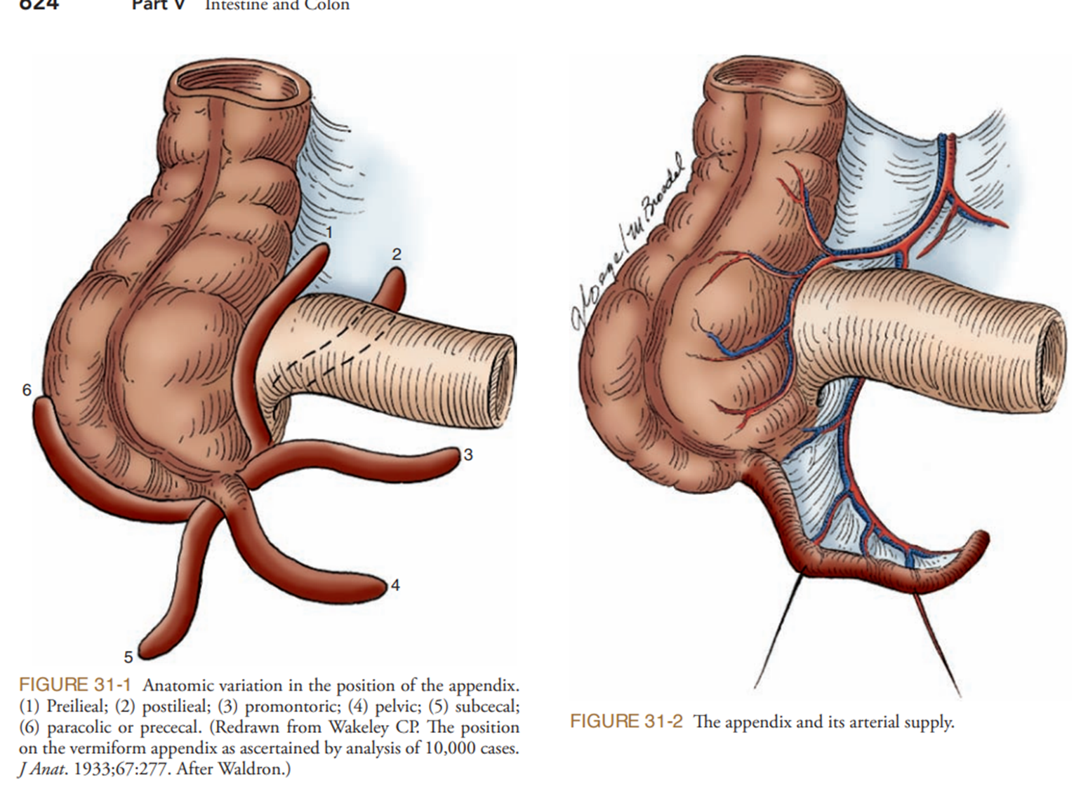

Slide 31
Laparoscopic Appendectomy
Done under GA
Patient is placed in the supine position
Bladder is emptied by catheter or voiding immediately before the procedure
Abdomen is entered at the umbilicus
Diagnosis is confirmed by inserting the laparoscope
Two additional working ports are then placed in LLQ or suprapubic area

Slide 32
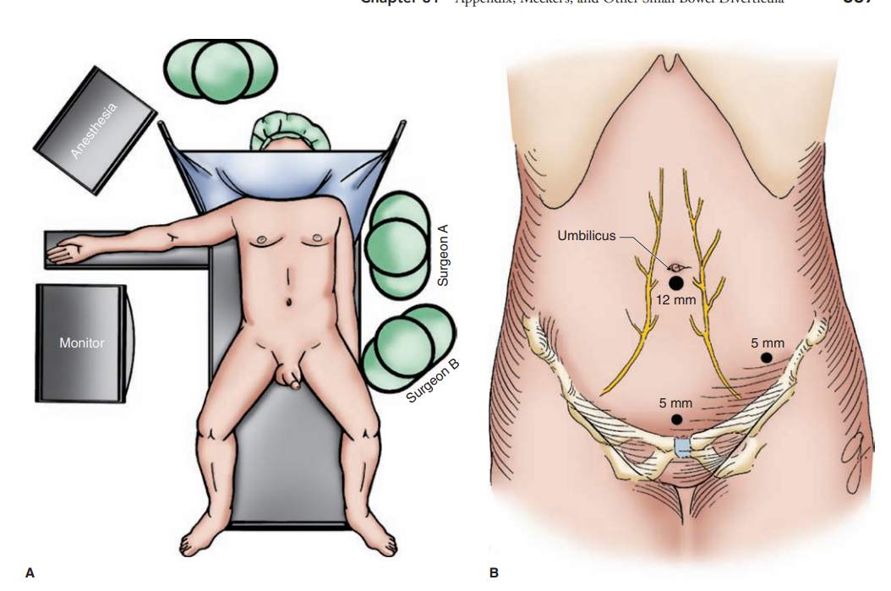

Slide 33
Laparoscopic appendectomy contd.
Both the surgeon and assistant stand to the left side of the patient with the left arm tucked
Atraumatic graspers are used to elevate the appendix
Mesoappendix is carefully divided using the harmonic scalpel
Base is then secured with endo loops and the appendix divided
Appendix is retrieved by plastic retrieval bag
Pelvis is irrigated thoroughly with N/S
Trocars are removed and the wounds are closed

Slide 34
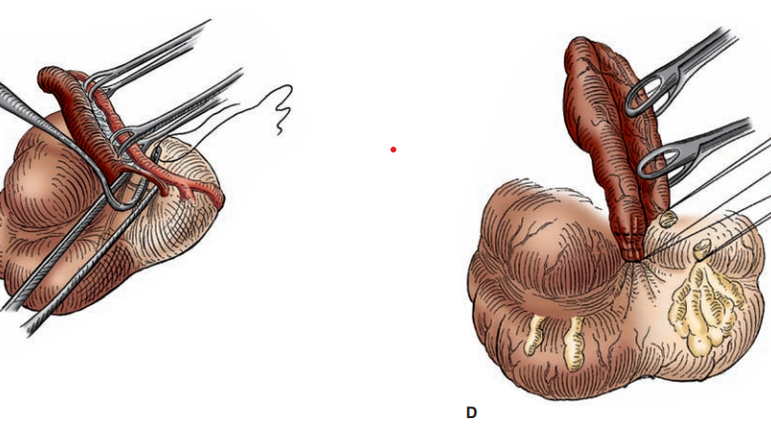

Slide 35
Laparoscopic appendectomy contd.
Advantages:-
Shorter length of stay (LOS)
Faster return to work
Lower rate of S.S.I.
Open appendectomy (Advantages):-
Shorter operative times
Lower intra-abdominal infection rates
Costs of the two techniques are relatively similar

Slide 36
Perforated Appendicitis
Operative strategy is similar to that for uncomplicated appendicitis
Except with a few exceptions:-
*Require a more aggressive pre-operative resuscitation
*Antibiotic therapy should be initiated immediately
Both the open and laparoscopic approaches are acceptable
Technique is the same as for simple appendicitis
Difficulty encountered in removing a friable, gangrenous, perforated appendix
Requires gentle handling of the friable appendix and inflamed peri appendiceal tissues to avoid tissue injury

Slide 37
Perforated Appendicitis contd.
Once the appendix is removed
Clearance of infectious material(spilled fecal material or fecaliths) from the abdomen
By irrigation with large-volume normal saline
With special attention given to the right lower quadrant and pelvis

Slide 38
Perforated Appendicitis contd.
Drains:-
Not routinely placed
If an abscess cavity present
Single closed suction Jackson-Pratt drain is placed
If an open technique was used
Skin and subcutaneous tissues are left open for 3 or 4 days
Prevent wound infection
Wound closed bed side later on

Slide 39
Perforated Appendicitis contd.
Broad-spectrum antibiotics continued for 4 to 7 days
If culture specimens obtained, antibiotic therapy is modified accordingly
Oral alimentation is begun after return of bowel sounds and passage of flatus
Once the patient is tolerating a diet, is afebrile, and has a normal white blood cell count
May be discharged home

Slide 40
Delayed Presentation of Appendicitis
Present several days to even weeks after the onset of appendicitis
Treatment is individualized on the basis of the nature of the presentation
Patient may present with:-
Diffuse peritonitis(Perforated appendicitis)
Localized right lower quadrant pain and fever(Mass)
History that is compatible with appendicitis
A mass may be palpable in children or thin patients

Slide 41
Treatment of Appendicular Mass
Exploration and attempted appendectomy may result in
Substantial morbidity
Failure to identify the appendix,
Postoperative abscess or fistula
Unnecessary extension of the operation
(to include ileocecectomy)

Slide 42
Treatment of Appendicular Mass contd.
Initial treatment for these patients is nonoperative
Fluid resuscitation and broad-spectrum antibiotic therapy
CT scan is obtained to confirm perforated appendicitis with a localized abscess or phlegmon

Slide 43
Treatment of Appendicular Mass contd.
Localized abscess is identified, CT-guided percutaneous drainage is performed
Drainage catheter is left in place for 4 to 7 day
Patient is treated with antibiotic therapy
If CT-guided drainage is not technically feasible
Operative drainage through transrectal or transvaginal approaches
Laparoscopic drainage is another option

Slide 44
Treatment of Appendicular Mass contd.
If appendicular lump or phlegmon is present
Patient may be treated with antibiotics alone for 4 to 7 days
After successful nonoperative treatment of complicated appendicitis
Interval appendectomy is advised(several weeks to months later)

Slide 45
Incidental Appendectomy
Term applied when a grossly normal appendix is removed at the time of an unrelated procedure
Such as a hysterectomy, cholecystectomy, or sigmoid colectomy
A controversial procedure
Theoretical benefit is eliminating the risk for development appendicitis in the future
Thought to be most beneficial in patients younger than 35 years because of their greater lifetime
Various studies S/O no additional benefit rather associated with an increase in both morbidity and mortality.

Slide 46
Appendicitis in special conditions
Appendicitis in the Pregnant Patient:-
Most common non obstetric emergency
Most frequent reason for surgical intervention in this group of patients
Surgeon must consider the welfare of two patients, the mother and fetus
Typical clinical presentation in only 50% to 60% of cases
Common symptoms of early appendicitis(nausea and vomiting)are nonspecific

Slide 47
Appendicitis in the Pregnant Patients contd.
Normal febrile response to illness may be blunted in pregnancy
Physical examination is difficult
Gravid uterus displace the appendix to a more cephalad location within the abdomen
Lower quadrant pain in the second trimester produced by traction on the suspensory ligaments of the uterus( Round Ligament Pain)
Further complicates the clinical picture because 50% of cases of appendicitis occur in the second trimester

Slide 48
Appendicitis in the Pregnant Patients contd.
Biochemical and laboratory indicators used to support the diagnosis are unreliable in pregnancy
Mild physiologic leukocytosis of pregnancy is a normal finding
C-reactive protein levels may also be physiologically elevated in pregnancy
Possibility of obstetric emergencies as a cause of abdominal pain, such as preterm labor, placental abruption, or uterine rupture
Negative appendectomy in pregnant patients, as high as 25% to 50%, when it is based on clinical presentation alone

Slide 49
Impact of Appendicitis on Pregnancy
Preoperative accuracy of diagnosis is crucial in the pregnant patients
Risk of preterm labor(11%) and fetal loss( 6%) with complicated appendicitis.
Lowest rates of preterm labor and fetal loss (6% and 2%, respectively) were seen in cases of uncomplicated.
Sensitivity (78%) and specificity (83%) of US appear to be reduced in pregnancy because of the presence of the gravid.

Slide 50
Impact of Appendicitis on Pregnancy contd.
If US findings are equivocal
MRI without gadolinium contrast is a safe alternative
Has excellent soft tissue contrast resolution and lack of ionizing radiation
Treatment options laparoscopic and open appendectomy

Slide 51
Appendicitis in the Elderly
Not the peak age for its occurrence
Expanded differential diagnosis that must be considered in the elderly
1. Acute diverticulitis (uncomplicated or complicated)
2. Malignant disease
3. Intestinal ischemia,
4. Ischemic colitis,
5. Complicated urinary tract infection, and
6. Perforated ulcer

Slide 52
Appendicitis in the Elderly contd.
Higher perforation rate in the elderly population(40% to 70%)
Coexistence of comorbidities resulting in higher morbidity
If pain is localized and peritonitis is absent, CT scanning of the abdomen should be performed
To confirm the diagnosis and to evaluate for other pathologic changes
Laparoscopic appendectomy is safe in the elderly
In severe cardiomyopathy open approach preferred to avoid the deleterious effects of pneumoperitoneum

Slide 53
Postoperative complications
Surgical Site Infection
Intrabdominal collections
Intestinal obstruction
Paralytic ileus
Lung atelectasis
Stump Appendicitis
Chronic pain
Incisional/port site hernia

Slide 54
THANK YOU

